Slide 1
Kafka Streams

Slide 2
Introduction
Alternative for streaming to and from Kafka
Part of the Apache Kafka
Powerful
Highly scalable, fault-tolerant
Rich feature set with support for both stateless and stateful processing
Support for fault-tolerant local state
Lightweight
Just a library integrated in Kafka (no external dependencies)
No need for dedicated clusters
Near real-time
Millisecond processing latency

Slide 3
Two API's
Kafka supports a low level API that can be used to manipulate streams
We'll focus on the Kafka Stream `DSL`
Higher level
Closer to other streaming ideas
Brining in some of the functional programming paradigms

Slide 4
What is Stream Processing?
S1
S2
S3
Programming with streams of data (even unbounded streams)
Typical traits
Functional
Apply a dataflow or a sequence of functions to the streams
Combining functions provides a powerful expression language (lambda expression)
Reactive
Process incoming stream data immediately upon receipt

Slide 5

The Obligatory Word Count Example
Word Counting Application
Producer
Kafka Stream API
words-topic
counts-topic
Consumer

Slide 6
Kafka Stream Classes
StreamsConfig
A wrapper around a map used for configuration
KStreamBuilder
The key class for setting up the stream procoessing
Based on the GoF Builder Pattern
Fluent API
Constructs the processing dataflow
KafkaStreams
A wrapper of the actual stream

Slide 7
Enable Kafka Stream (Using Maven)
<dependency>
<groupId>org.apache.kafka</groupId>
<artifactId>kafka-streams</artifactId>
<version>0.10.1.1</version>
</dependency>
Kafka Streams are distributed as a simple jar file
Simply include the jar file in your program and you'll be able to use the streaming library

Slide 8
Programming to Stream
// Configure
Properties props = new Properties();
pros.put(StreamsConfig.CLIENT_ID_CONFIG, "...")
...
StreamsConfig config = new StreamsConfig(props);
// Serialization/deserialization
Serde<String> serDeser= Serdes.String();
// Create the data processing pipeline
KStreamBuilder bld = new KStreamBuilder();
bld.stream(serDeser, serDeser, "topic")
.map(...) ...
// Create stream
KafkaStreams sp = new KafkaStreams(bld, config);
// Start stream
kafkaStreams.start();

Slide 9
Word Count Streaming
StreamsConfig config = new StreamsConfig(props);
Serde<String> serde = Serdes.String();
KStreamBuilder bld = new KStreamBuilder();
bld.stream(serde, serde, "words-topic")
.flatMapValues(text -> asList(text.split(" ")))
.map((key, word) -> new KeyValue<>(word, word))
.countByKey(serde, "Counts")
.toStream()
.map((word, count) ->
new KeyValue<>(word, word + ":" + count))
.to(serde, serde, "counts-topic");
KafkaStreams s= new KafkaStreams(bld, config);
s.start();

Slide 10
kafkacat – A Useful Tool
kafkacat is a tool created by Magnus Edenhill
https://github.com/edenhill/kafkacat
Doesn't require JVM
Similar to 'netcat'
Can act as a Producer and consumer
Useful also to query metadata from Kafka
To provide the word list to the application, we could simply use kafkacat instead of writing new producers and consumers
Use as a producer
kafkacat –P –b myBroker –t topic1
Use as a consumer
kafkacat –b myBroker –G mygroup topic1 topic 2

Slide 11
Installing kafkacat
The installation of kafkacat is trivial on Mac most Linux distrobutions
Mac
brew install kafkacat
Ubuntu or Debian
[sudo] apt-get install kafkacat
Our Kafka docker image is using Alpine distribution so if you want to run it in the docker image you'll have to:
apk add --update alpine-sdk bash python cmake
curl https://codeload.github.com/edenhill/kafkacat/tar.gz/master | tar xzf - && cd kafkacat-* && bash ./bootstrap.sh

Slide 12
Processor Topology
source processor
stream processor
stream
sink processor
The topology defines the computational logic of the data processing pipeline
The topology typically forms a chain, but more advanced computation may be defined as a graph

Slide 13
Processing and Time
In streaming time is an important design consideration
When working with concepts such as windowing, it is essential to establish which time to use
Event-time
The point in time when an event or data record was created by the source
Processing-time
The point in time when an event was processed by the stream processor
Ingestion-time
The point in time when an event was stored in a topic partition by one of the Kafka brokers

Slide 14
Stateful Stream Processing
Typically we try to make our stream processing stateless
However, for some use cases, stateful streaming may be essential
The Kafka Stream DSL provides support for stateful processing

Slide 15
Stream vs. Table
Kafka streams introduces the concept of tables, where
A stream can be viewed as a table: KStream → KTable
A table can be viewed as a stream: KTable → KStream
(called stream-table duality)
Streams as tables
A stream can be considered a changelog of a table
One can convert the stream into a table by replaying the event stream
Table as streams
A table can be be converted into a stream by iterating over each key-value entry

Slide 16
Windowing
We may have to process data in time buckets, called windows
Typically as part of some form of aggregation
Windowing operations are available in the Kafka Stream DSL
A window has a retention period to handle possible late arriving events

Slide 17
Parallel Stream Processing Pipelines
The Kafka Stream DSL supports ways to parallelize and rendezvous processing steps
Join
This operation merges two streams into a single stream
Aggregation
Takes one input stream and yields a new stream by combining multiple input events into a single output event

Slide 18
Backpressure
Kafka Streams don't need a backpressure mechanism
Kafka uses a depth-first processing strategy
Each event consumed from Kafka goes through the complete processor topology before the next message is processed

Slide 19
Summary
Kafka provides a stream processing library
Two APIs
Low level API
Kafka Stream DSL
The Kafka Stream DSL enables the definition of processing topologies
Kafka streams support stateful stream processing
Kafka has a reach support of functions and features
Windowing
Aggregation
Join
Functions (map, flatMap, etc.)

Slide 20
Lab
Lab 1: Word count using Kafka Streams
I will show this in slides
Lab 2: Word count in Spark
I'll leave that for you to do after the class
Lab 3: IoT example in Spark
I'll walk you through the code
Example 4: IoT example implemented in Kafka Streams
I'll walk you through the code

Slide 21
Step 1: Setup Your docker.yml File
We've done this before...
The docker-compose.yml file is in the directory:
kafka-lab/labs/06-Streaming/docker
Modify the KAFKA_ADVERTISED_HOST_NAME to refer to the IP of your machine
Notice that in this docker-compose file we have more processes:
ZooKeeper
Kafka
Spark Master
Spark Worker

Slide 22
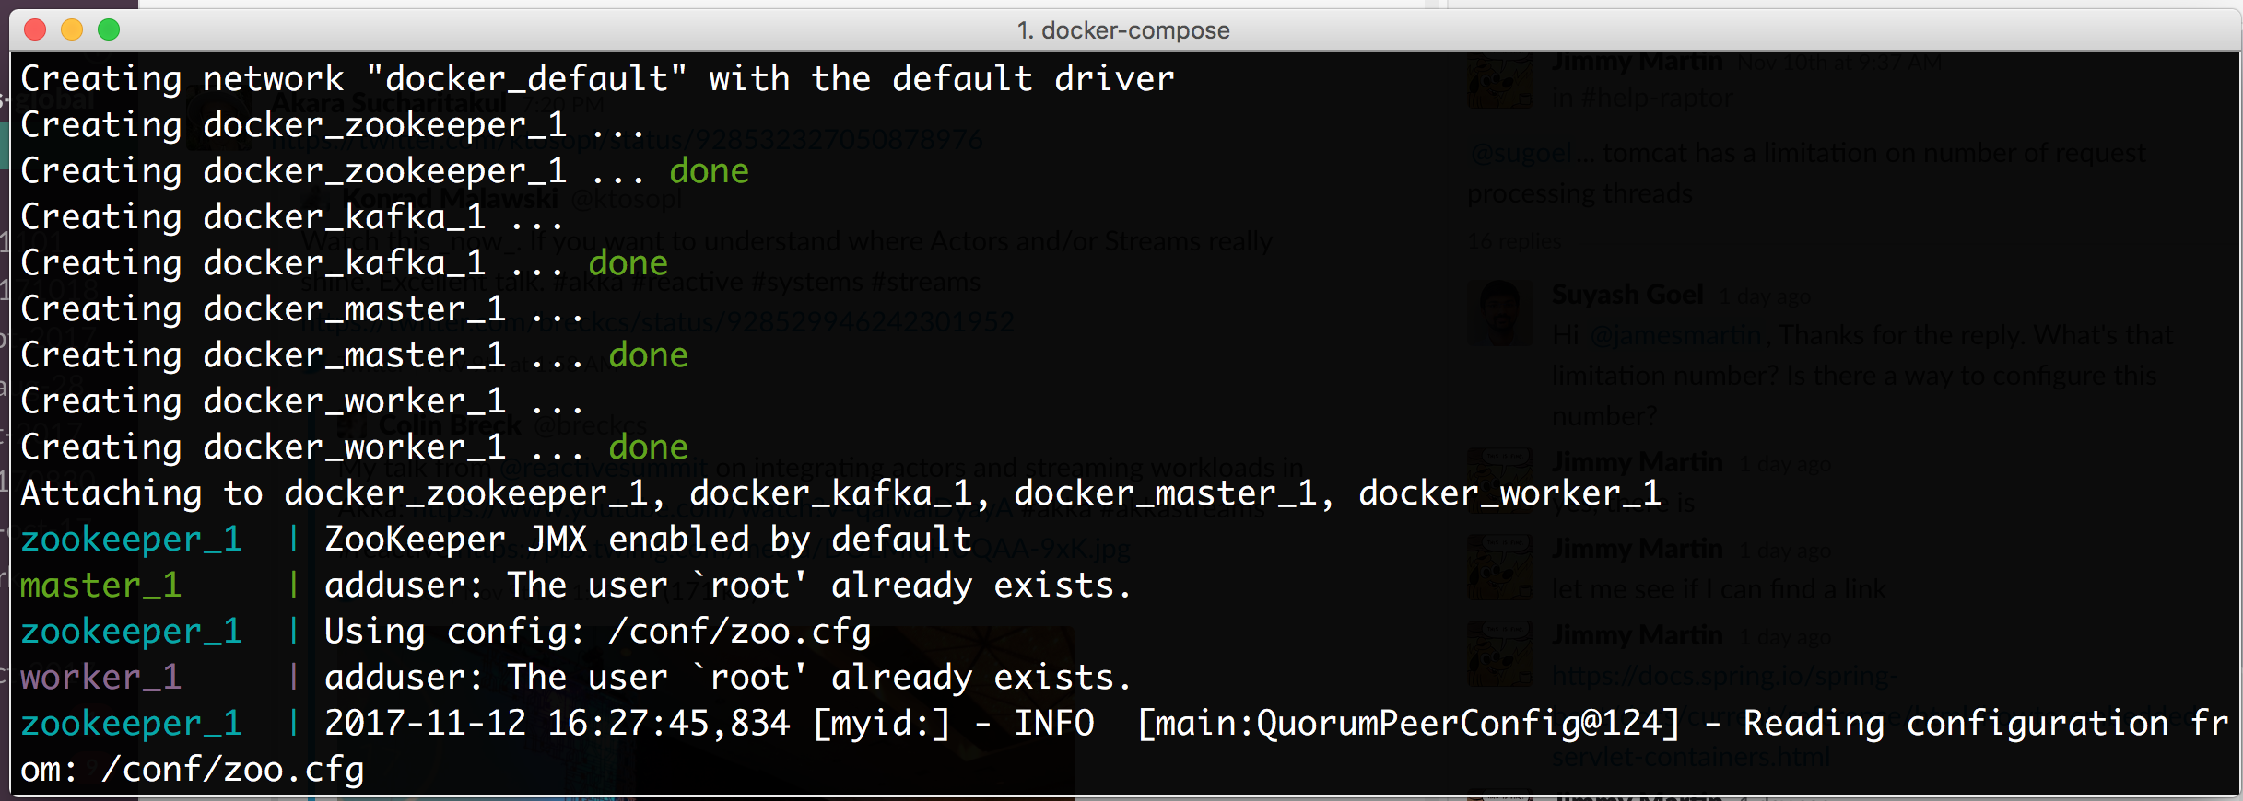
Step 2: Start Your Docker Processes
Start your processes with: docker-compose up

Slide 23
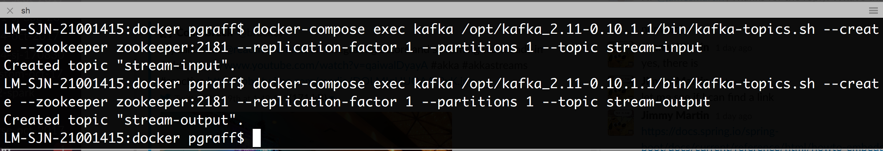
Step 3: Create Some Topics
Start a new terminal (you may want to keep this terminal to eventually shutdown the docker containers)
For the word-count we'll have two topics:
stream-input
stream-output
Use the docker-compose exec to create the topics:

Slide 24
Step 4: Create a Console Consumer
Let's create a console consumer to listen to the end result
In a separate terminal
Change to the docker directory
Run a console consumer listening to the stream-output: docker-compose exec kafka /opt/kafka/bin/kafka-console-consumer.sh --bootstrap-server localhost:9092 --topic stream-output --from-beginning --property print.key=true
Prints the key as well as the value of each message

Slide 25
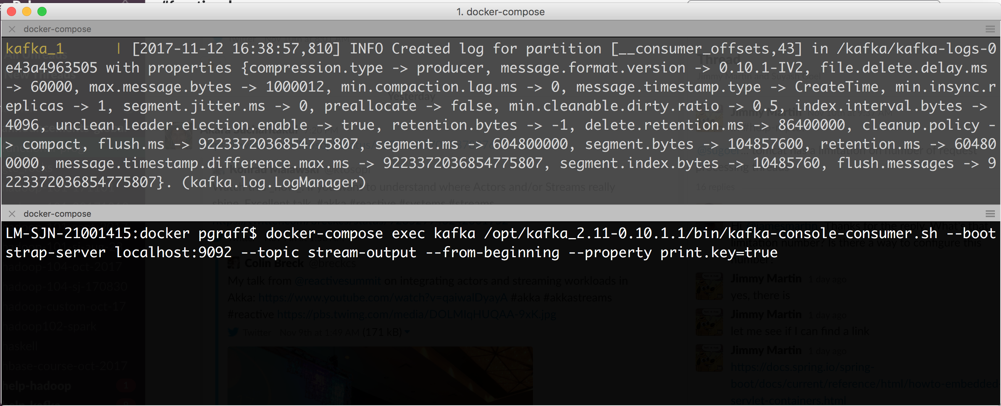
Where Are We?
docker containers
(kafka, zookeeper, master, worker)
console-consumer listening to stream-output

Slide 26
Step 5: Create a Console Producer
We also need to be able to produce the input data
Open a terminal and change directory to the docker directory
Run the console-producer: docker-compose exec kafka /opt/kafka/bin/kafka-console-producer.sh --broker-list kafka:9092 --topic stream-input

Slide 27
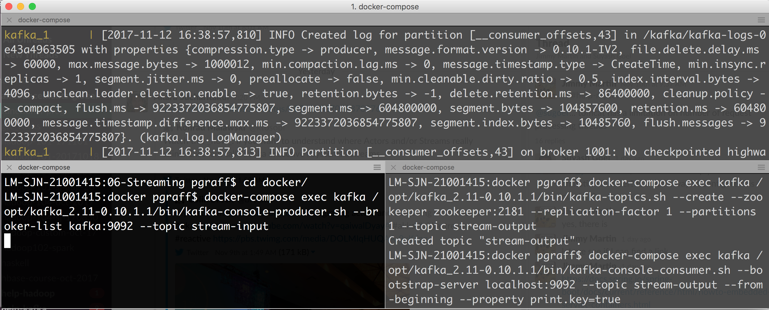
Where Are We?
docker containers
(kafka, zookeeper, master, worker)
console-producer
producing to
stream-input
console-consumer
listening to
stream-output

Slide 28
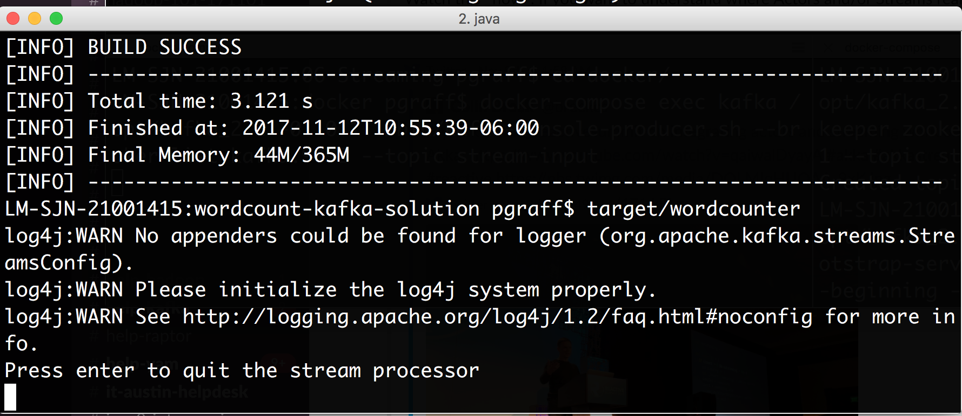
Step 6: Build and Run the Stream Processor
Open a terminal and change directory to the wordcount-kafka-solution
Run mvn package and after that target/wordcounter

Slide 29
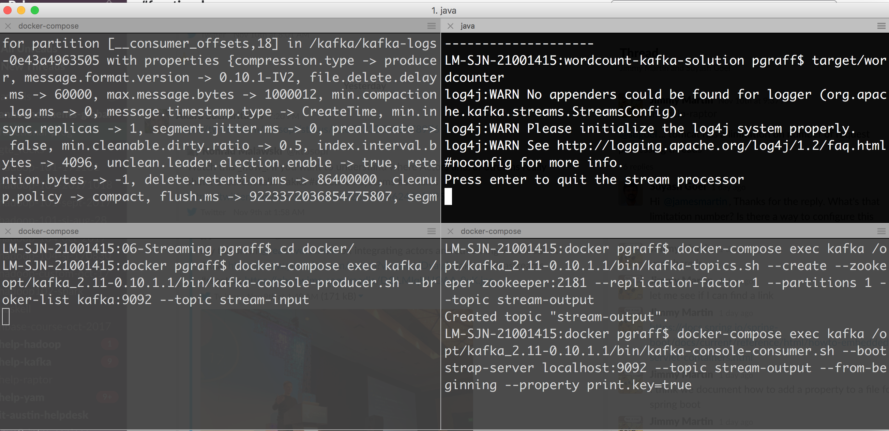
Where Are We?
docker containers
The event processor
console-producer
producing to
stream-input
console-consumer
listening to
stream-output
www.scispike.com
29

Slide 30
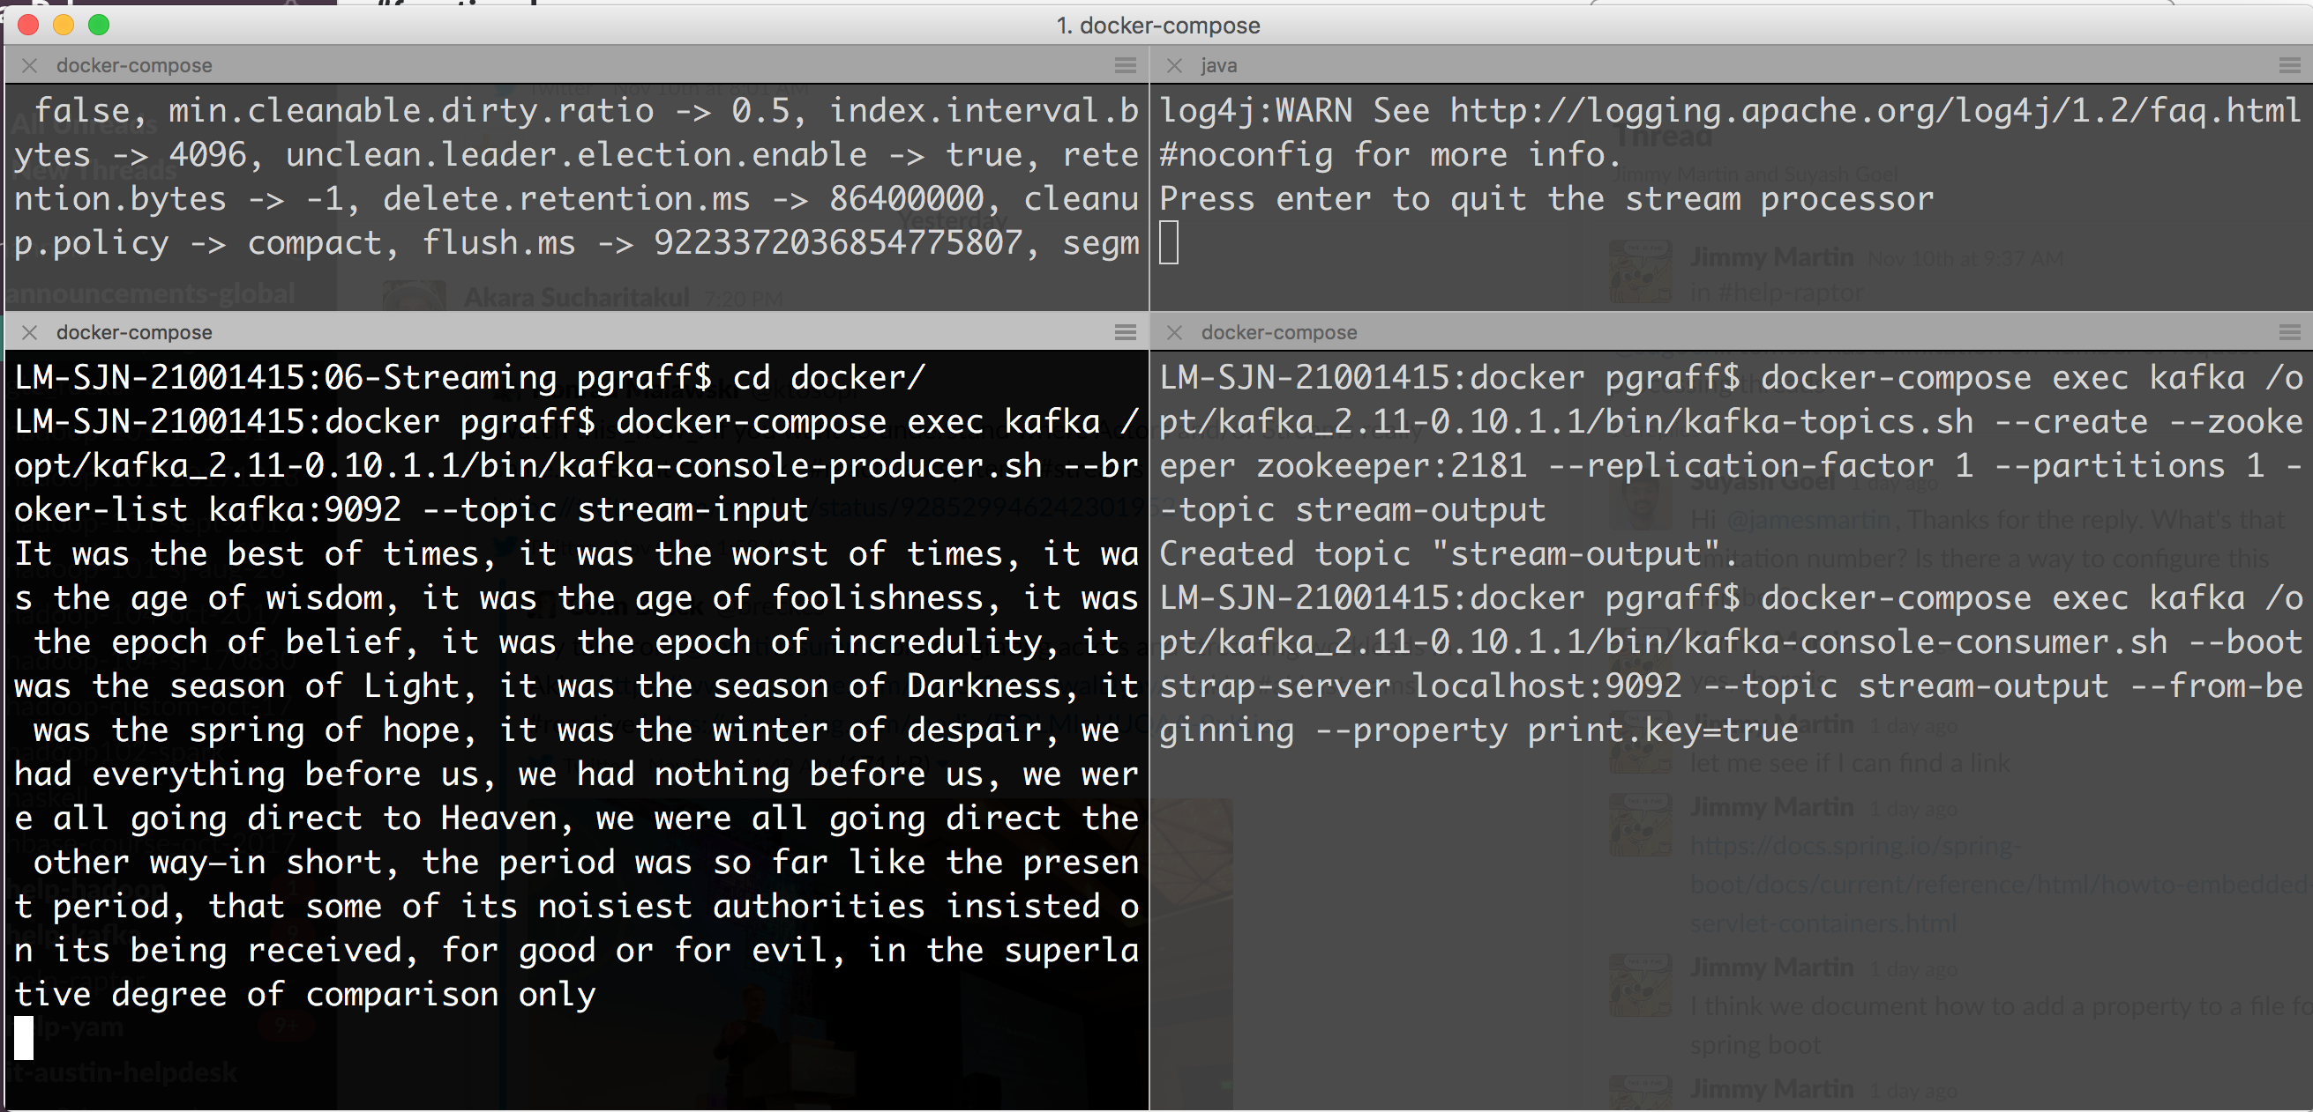
Step 7: Enter Some Text in the Producer

Slide 31
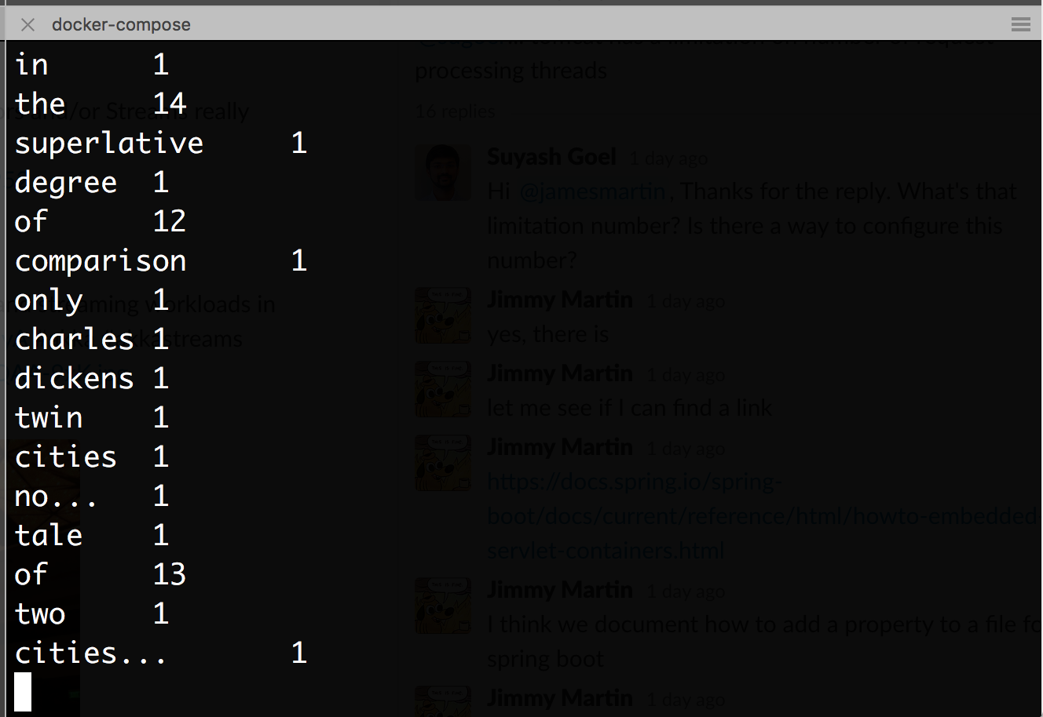
After some time...

Slide 32
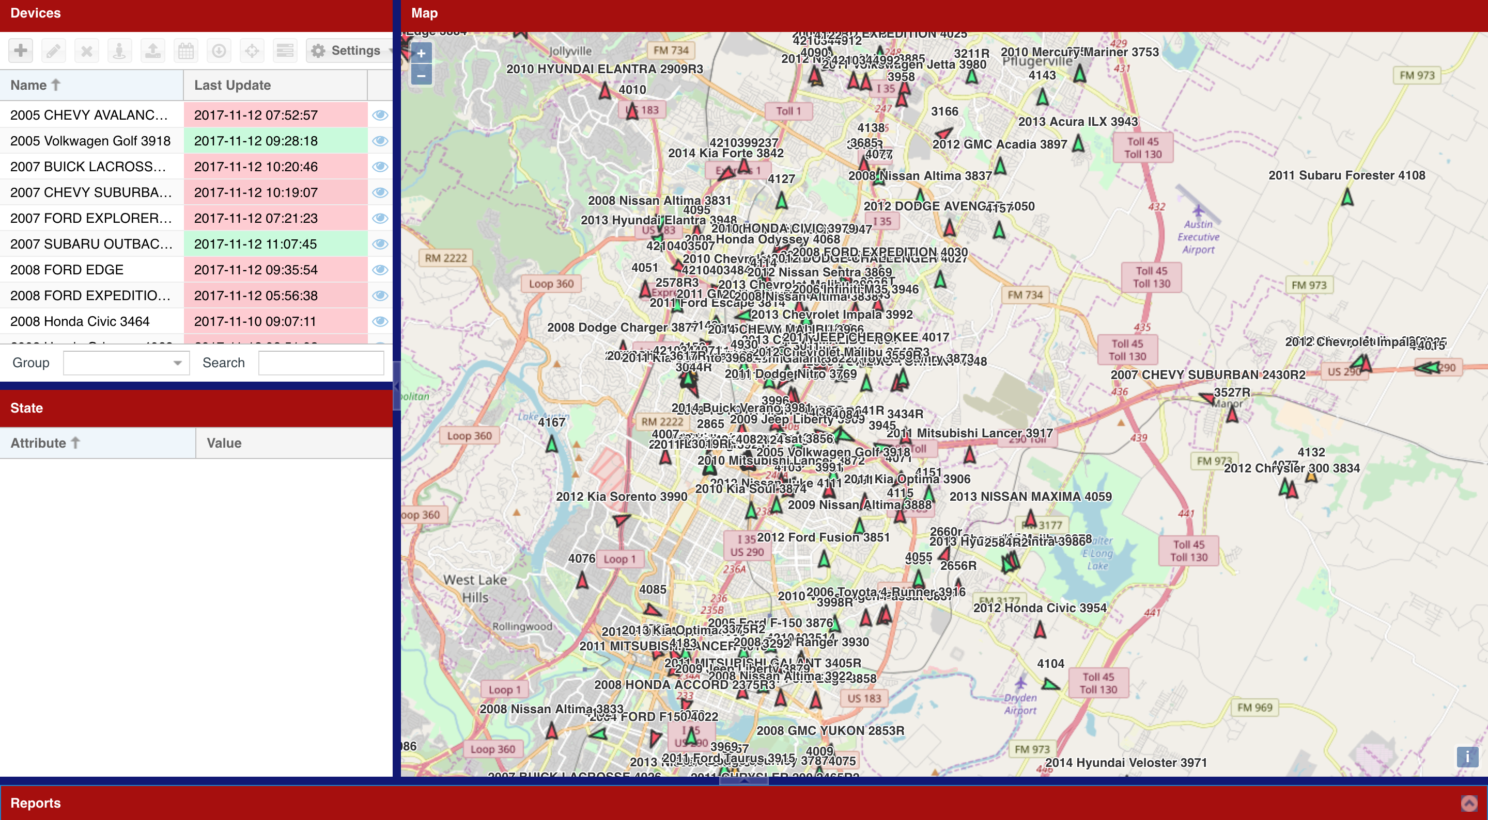
Lab/Example: Another Problem

Slide 33
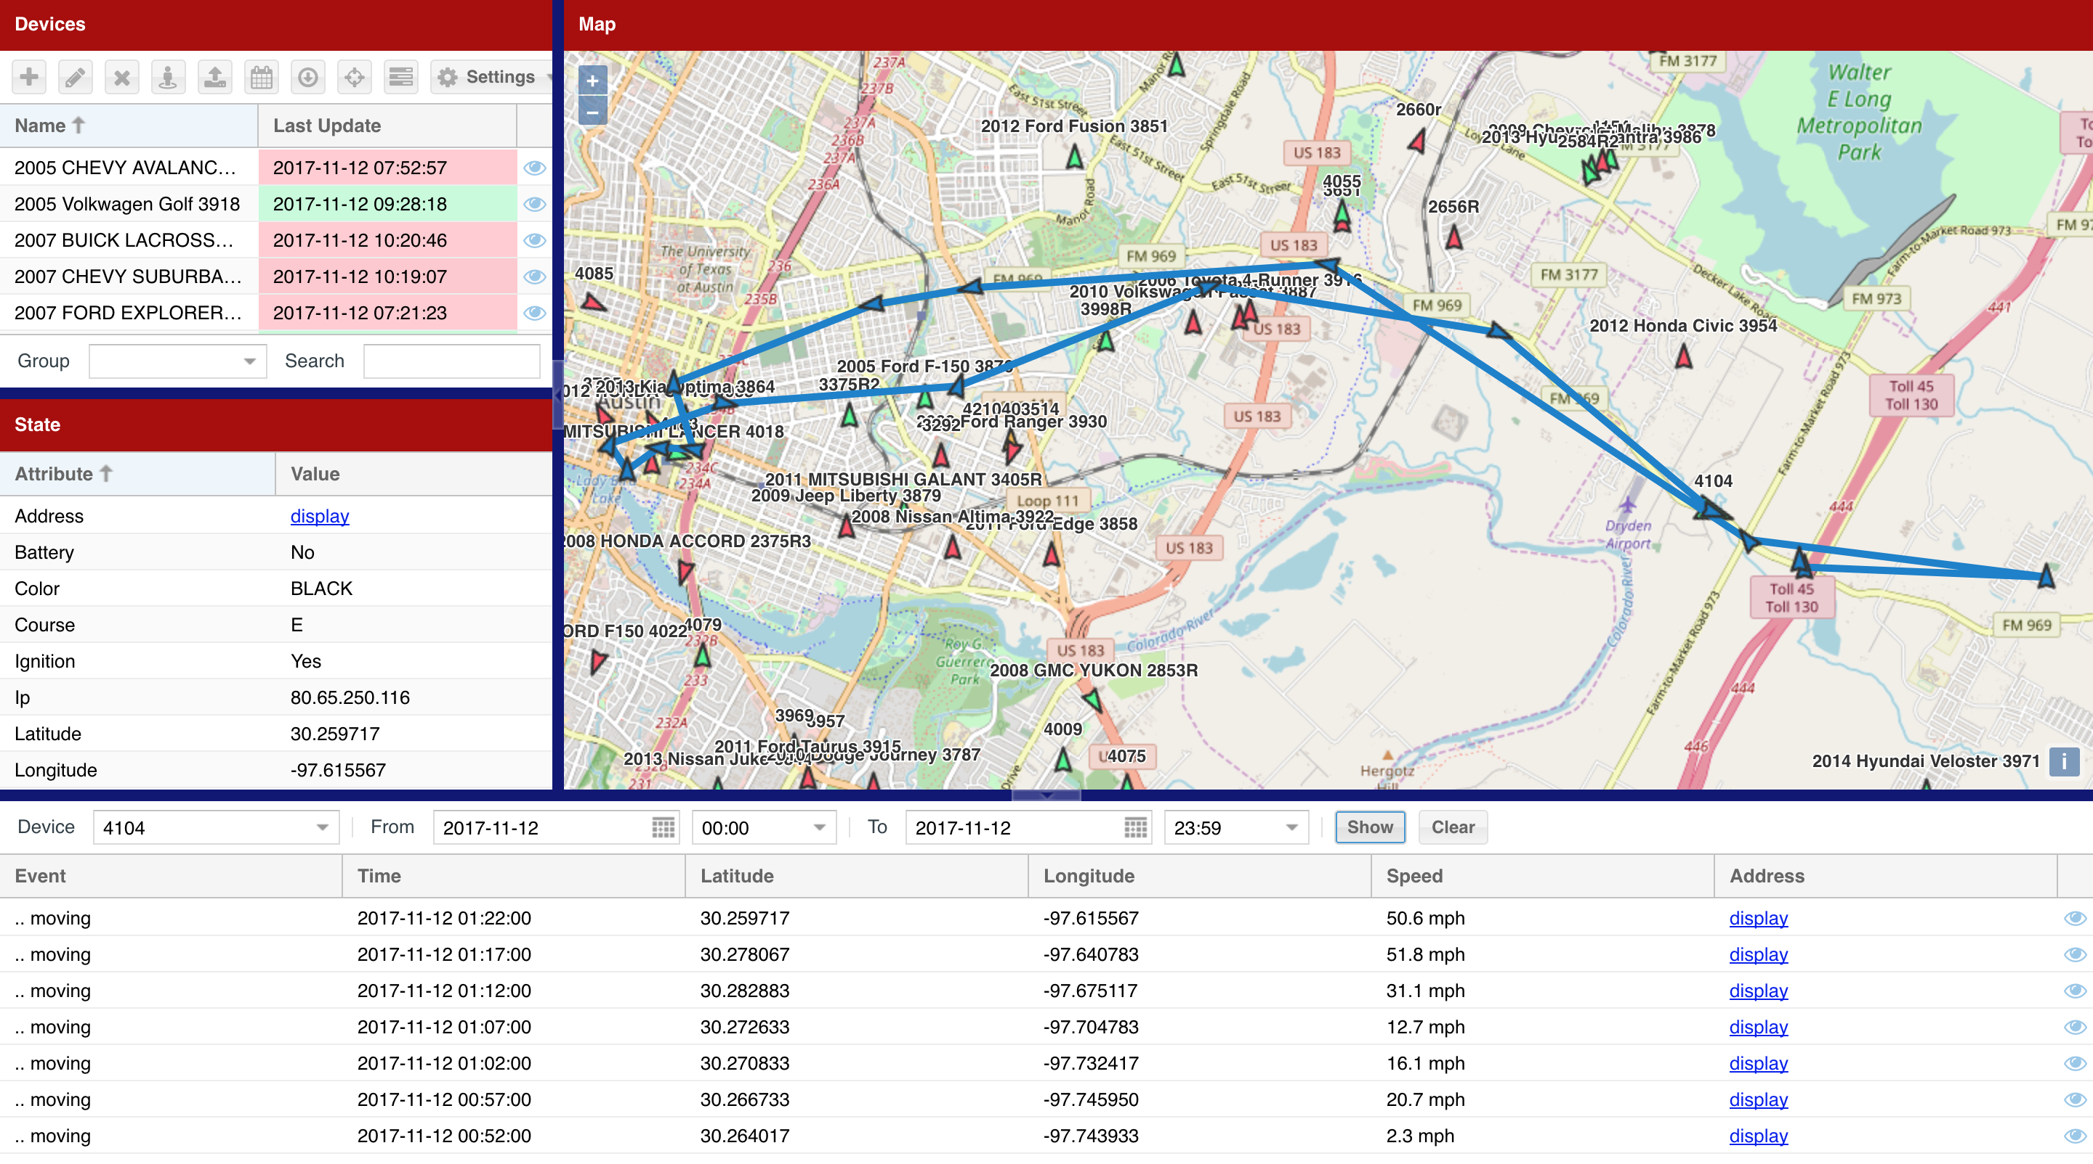

Slide 34
Example Description
We get a stream of vehicle locations
Each location contains:
Vehicle ID
Data of observation
Speed
Direction
Latitude
Longitude

Slide 35
Problem and Plan
We want to know where the vehicle is most likely to be parked
Our plan
Parse the vehicle data from an input stream
Filter out the only those locates where the vehicle was at rest
Convert the vehicle locate into keys that we can accumulate. The key would be based on
Vehicle ID
Geo location
Group the locates together by key and count them
Stream the frequent parking count to another stream

Slide 36
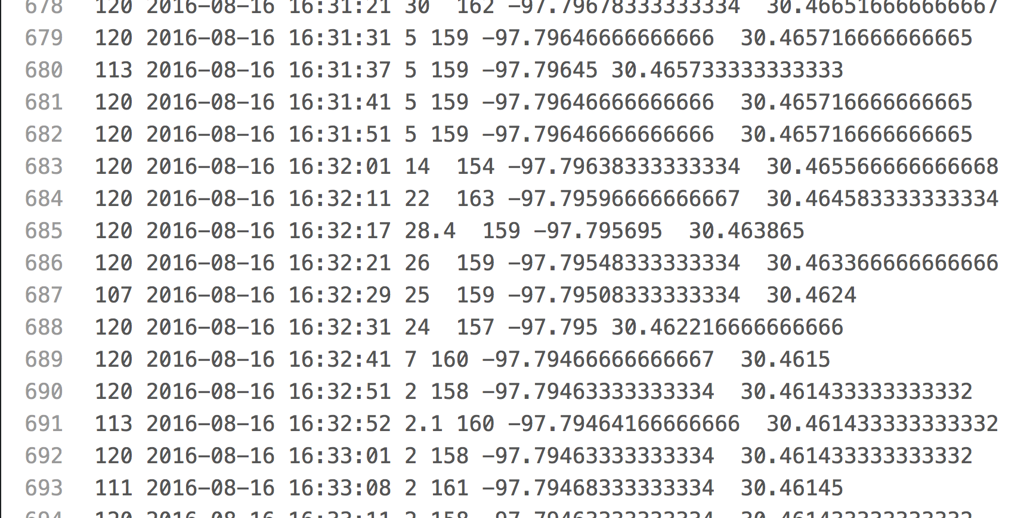
Input File: vehicle_1_to_1000.tsv

Slide 37
Message Pump – The Simulator
We've created a message pump application to simulate the vehicle input
You can find this implementation in the directory: kafka-lab/labs/06-Streaming/iot-kafka-solution/gps-pump
The implementation reads the TSV file and produces messages into a topic called: gps-locations
In the real world, we would have to write some edge servers that receives the data from the vehicles and publish the topic into the topic

Slide 38
Event Processor
We've created an event processor based on kafka-streaming (and another on Spark that we'll look at later)
You can find this implementation in the directory: kafka-lab/labs/06-Streaming/iot-kafka-solution/processor
This processor uses kafka-streams to read the events from the topic gps-locations and produces messages on the topic frequent-parking
The messages produced:
Key: Vehicle and location key based on GeoHash
Value: parking count

Slide 39
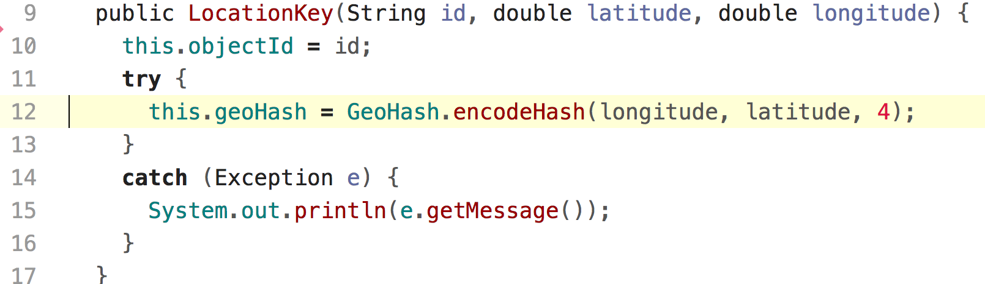
GeoHash
We build a key based on the vehicle id and a GeoHash
GeoHash allows us to focus on an area instead of absolute locates

Slide 40
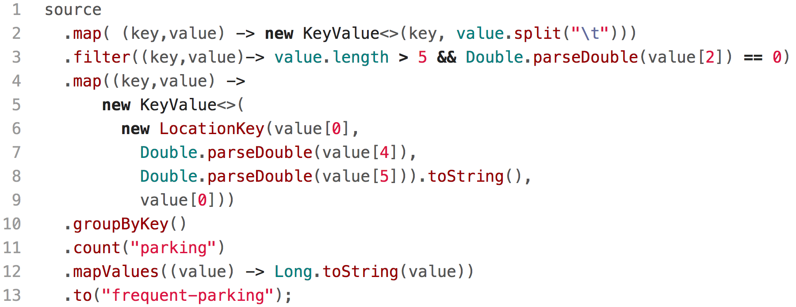
Kafka Stream Solution

Slide 41
Run Solution in Kafka
Modify the docker-compose file to use your (which you may already have done in the word-count exercise)
Create the topics:
gps-locations
frequent-parking
Run a kafka-consumer to listen to the frequent-parking topic (with the show key property)
Build and run the message pump
Build and run the processor
Wait to see the parking counts...

Slide 42
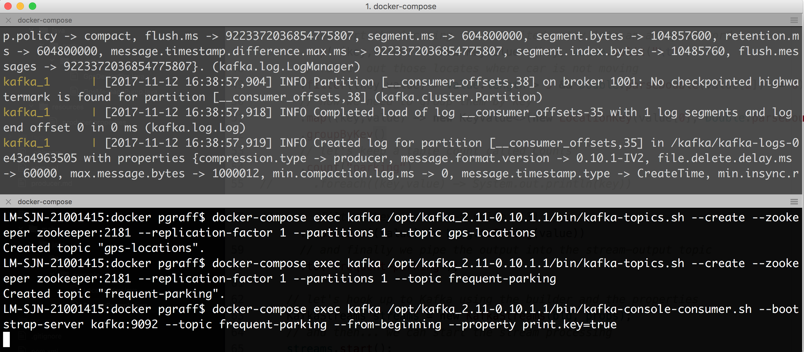
Creating the Topics and Start the Console Consumer

Slide 43
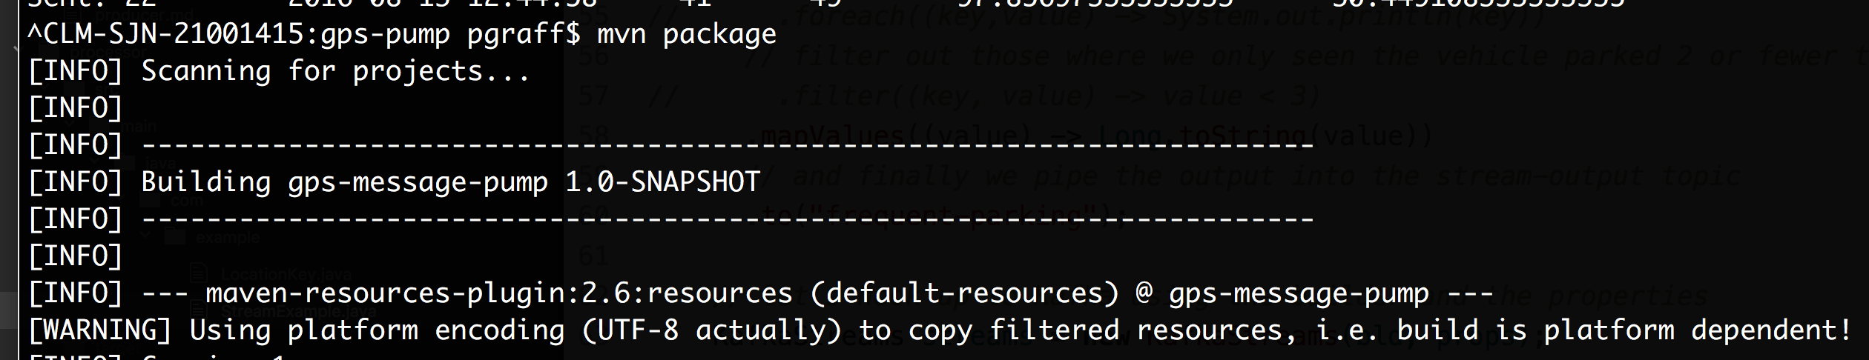
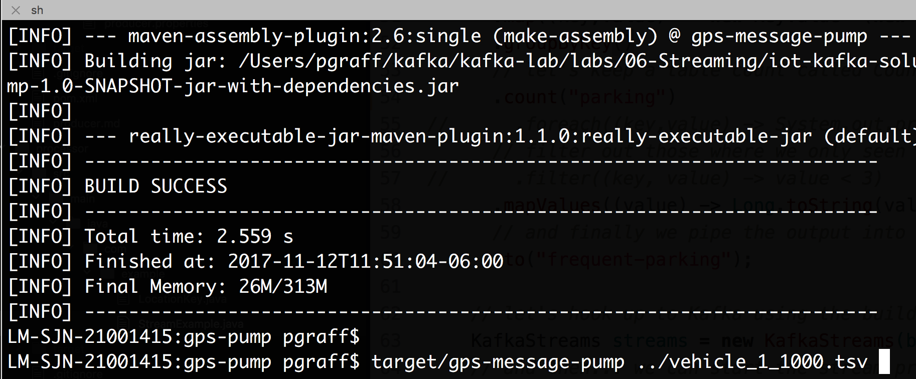
Build and Start the Message Pump

Slide 44
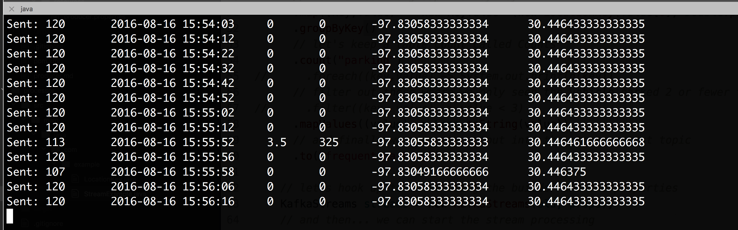
Output

Slide 45
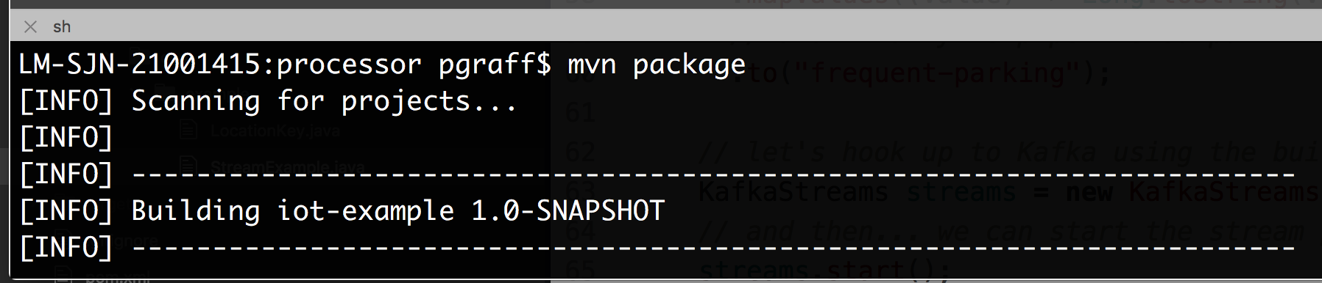
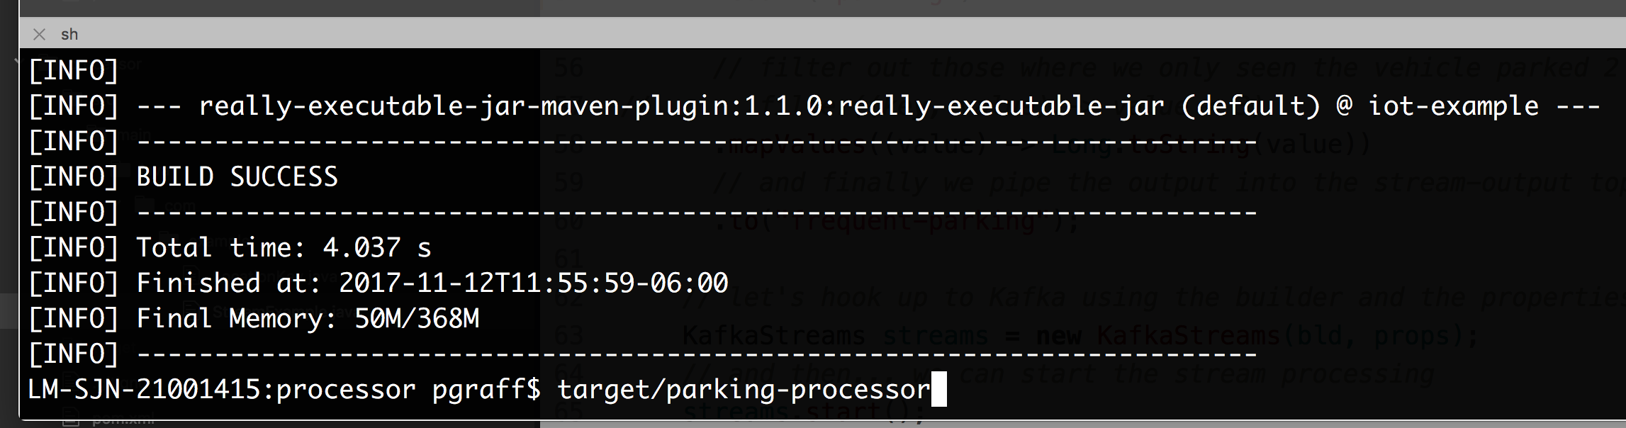
Build and Start the Processor

Slide 46
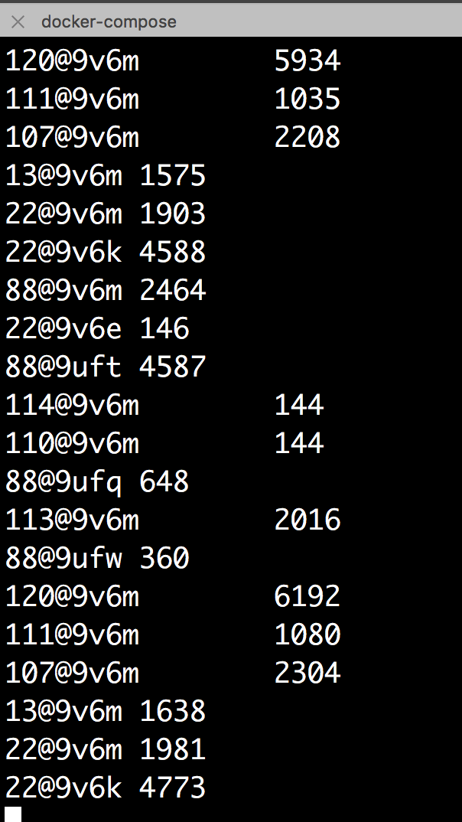
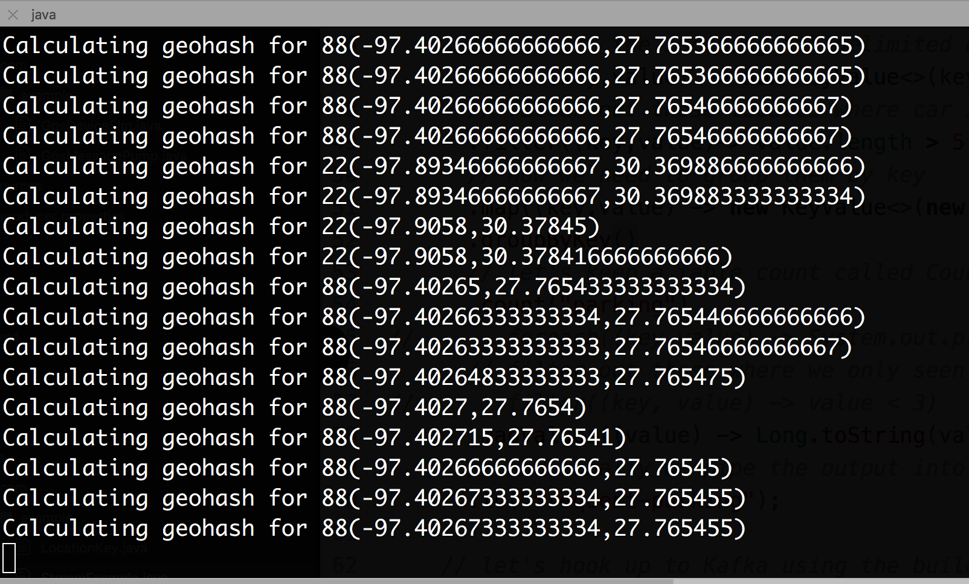
Output

Slide 47
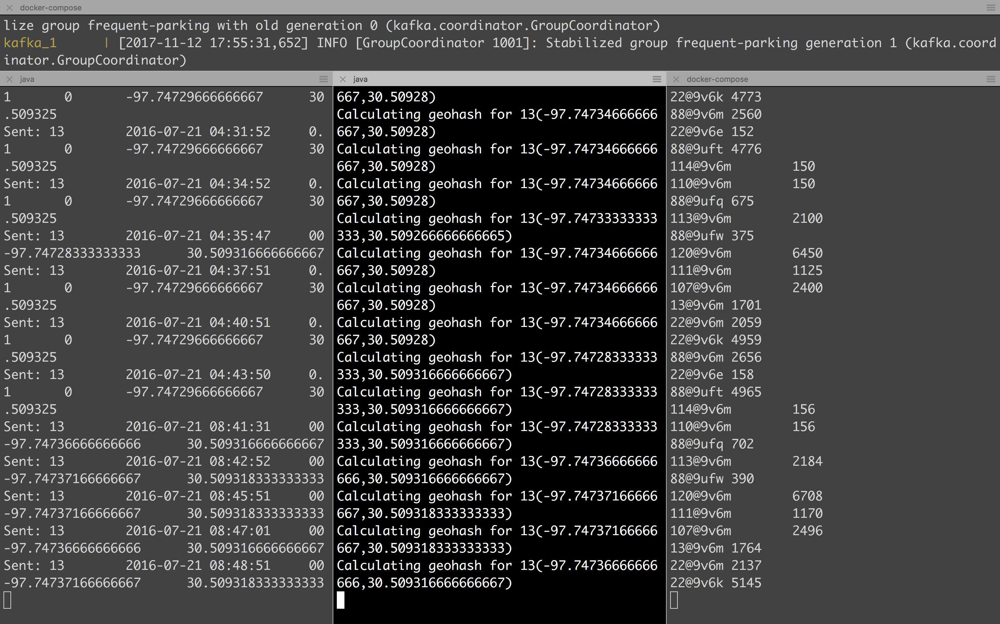
TOPIC
gps-locations
TOPIC
frequent-parking
Data is produced in the message-pump
Then Processed in the parking-processor
Then finally printed in the console consumer

